Slide 1
HOTEL MANAGEMENT SYSTEM
GROUP : 3
Members
1.Ajmal T P
2.Bilal
3.Nithin

Slide 2
INTRODUCTION
In this project we introduce a Hotel Management System using python & MySQL database.This is a light weight software that runs on basic computers. The system includes a range of automated front-desk tasks, such as check-in and check-out, room assignments, and billing. It also provides staff with real-time information about guest preferences, history, and contact information to help personalize the guest experience. The system can manage room inventory, schedule and manage staff, provide inventory control, reporting, marketing and customer relation management.

Slide 3
ABSTRACT
This paper presents a comprehensive hotel management system designed to improve the efficiency and productivity of hotel operations, while enhancing the guest experience. The system includes a range of automated front-desk tasks, such as check-in and check-out, room assignments, and billing.
It also provides staff with real-time information about guest preferences, history, and contact information to help personalize the guest experience.
The system can manage room inventory, schedule and manage staff, provide inventory control, reporting, marketing and customer relation management.
Additionally, it offers a mobile integration and robust security features to protect sensitive customer information.
The system was implemented and tested in a hotel setting, and results demonstrate significant improvements in staff productivity and guest satisfaction

Slide 4
How It Works
As this software product is used in the receptions of hotels we collect some basic customer details first for the registration of the customer.
Later we fetch the details of customer using their contact number to the check in page and we calculate the total amount and the advance to be paid based on the customer requirements number of staying date and the category of the room.
The customer can choose their foods according to their needs and that bill is added while the customer vacate the room and total bill is generated
If the hotel gets developed and new rooms can be added to the software easily be the admins without having help from developer side as it is easy to use
We provide basic login functions to the staff who works in the reception by using their staff id and password
The datas are stored can be used for the better customization.

Slide 5
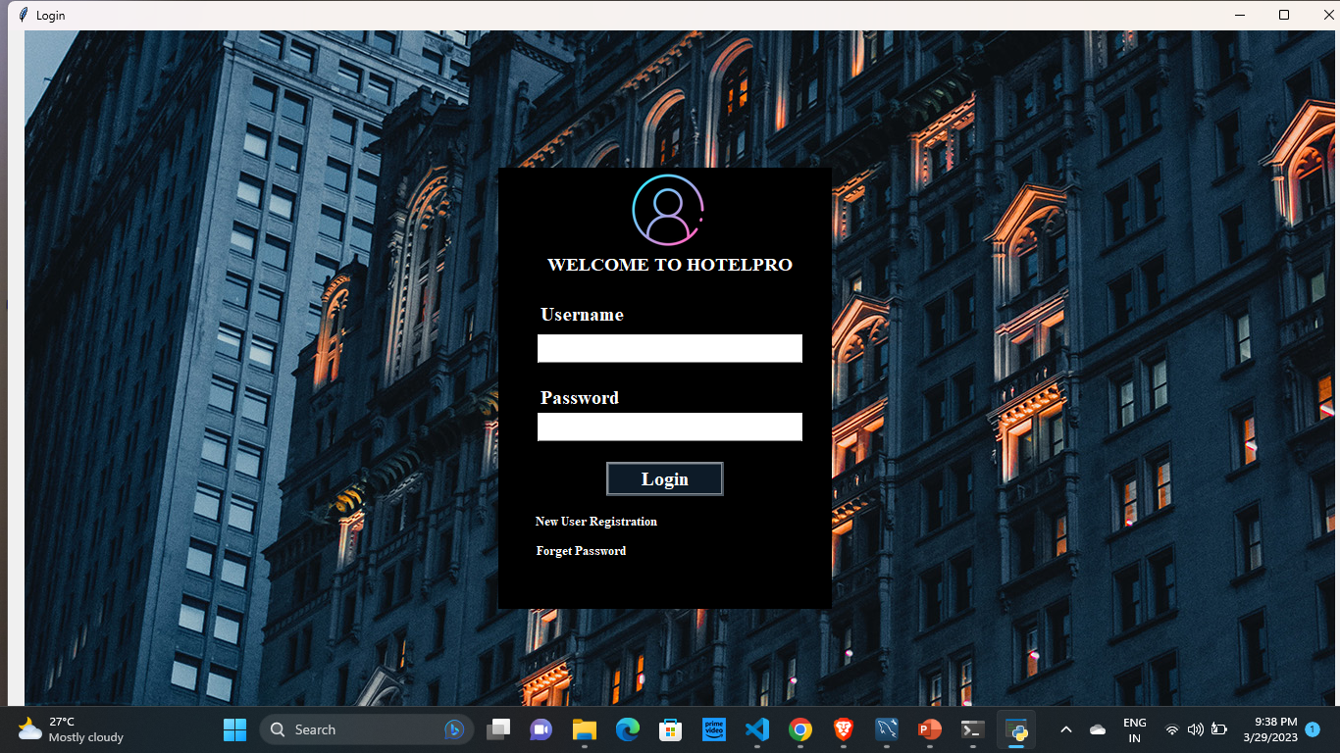
LOGIN MODULE

Slide 6
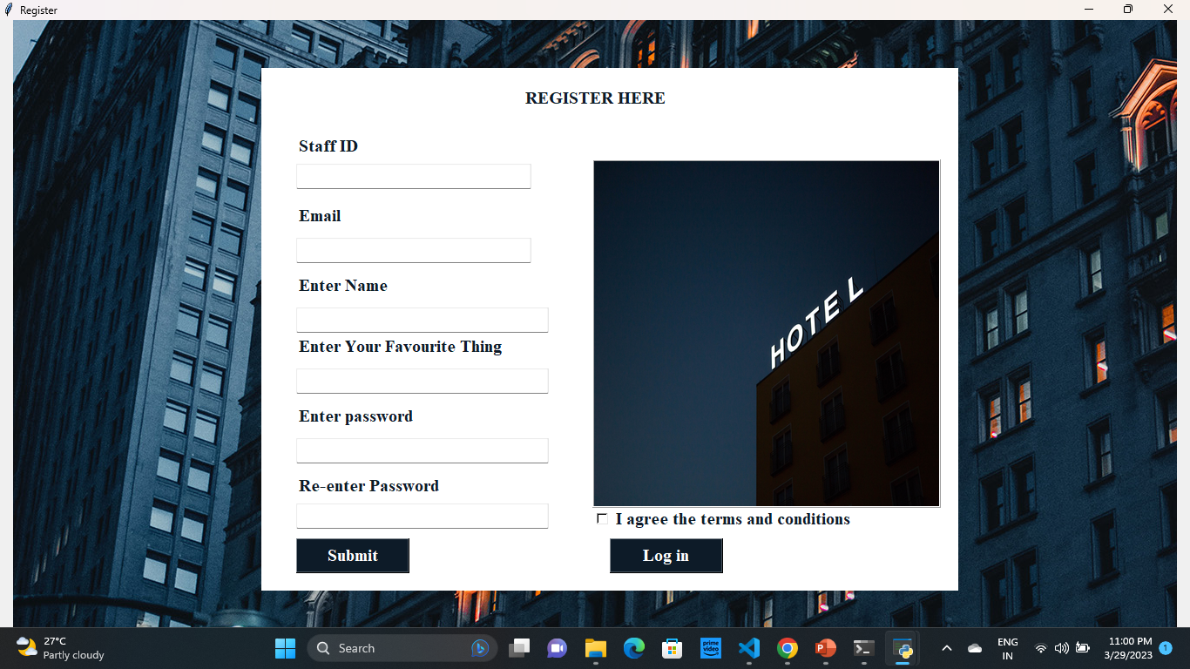
USER REGISTRATION

Slide 7
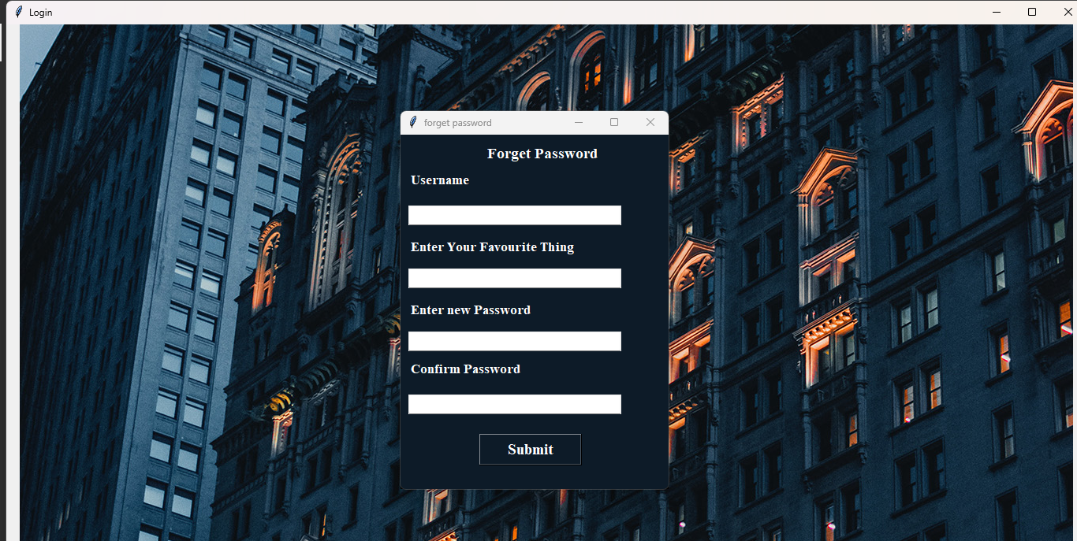
FORGET PASSWORD WINDOW

Slide 8
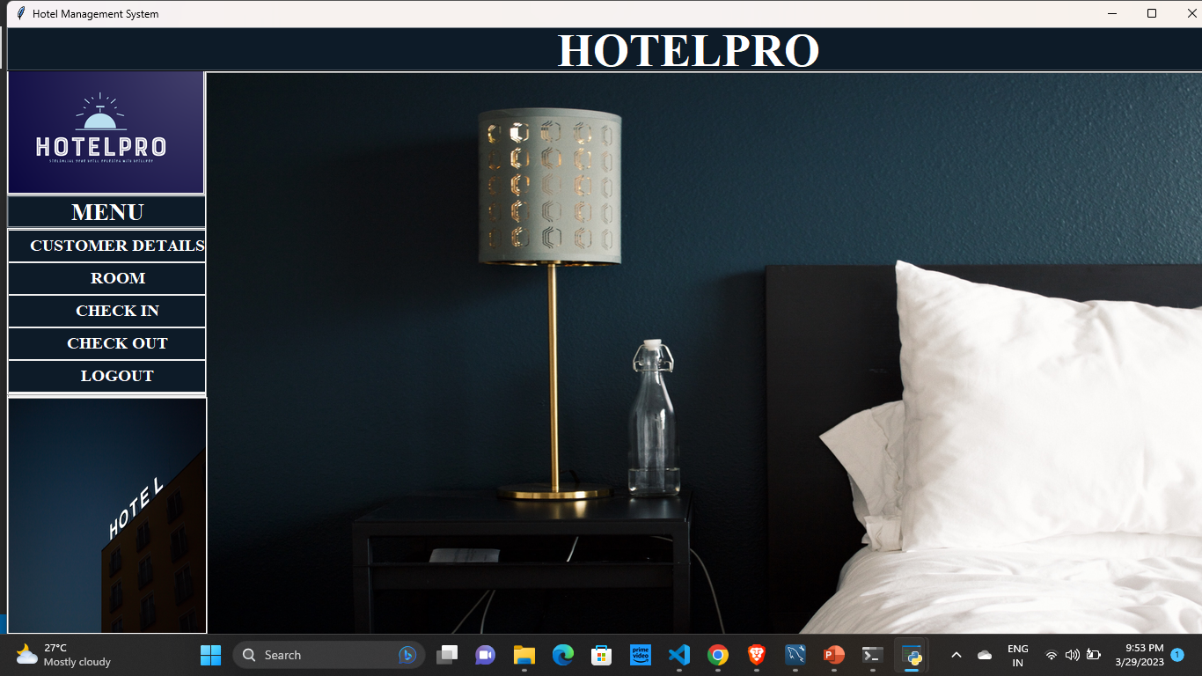
To access customer details
To add new room
To check-in customer
To check out customer
HOME PAGE

Slide 9
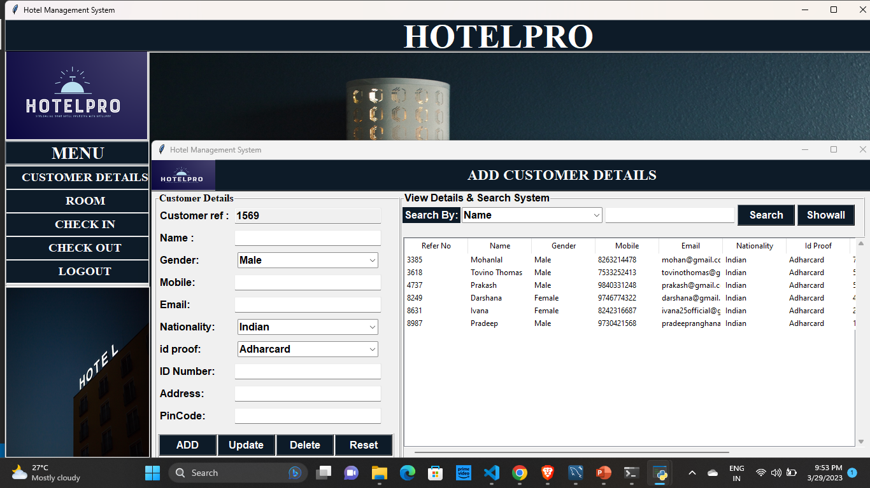
To add data to
table
To update data in the table
To delete data in the table
To reset data

Slide 10
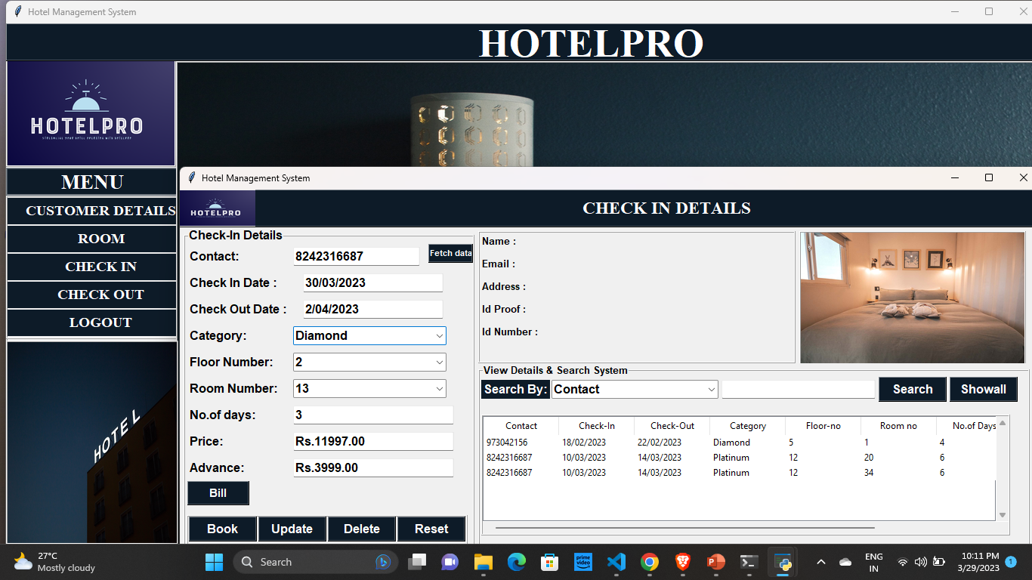
Retrieved data from database will displayed Here
Fetch data buttons are used to fetch customer details and room details from the database

Slide 11
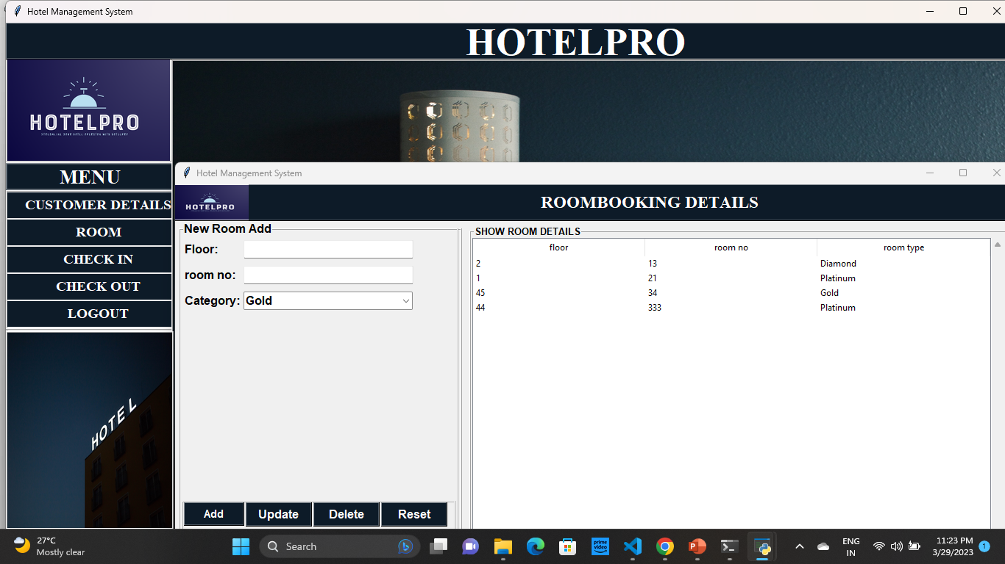
ROOM DETAILS

Slide 12
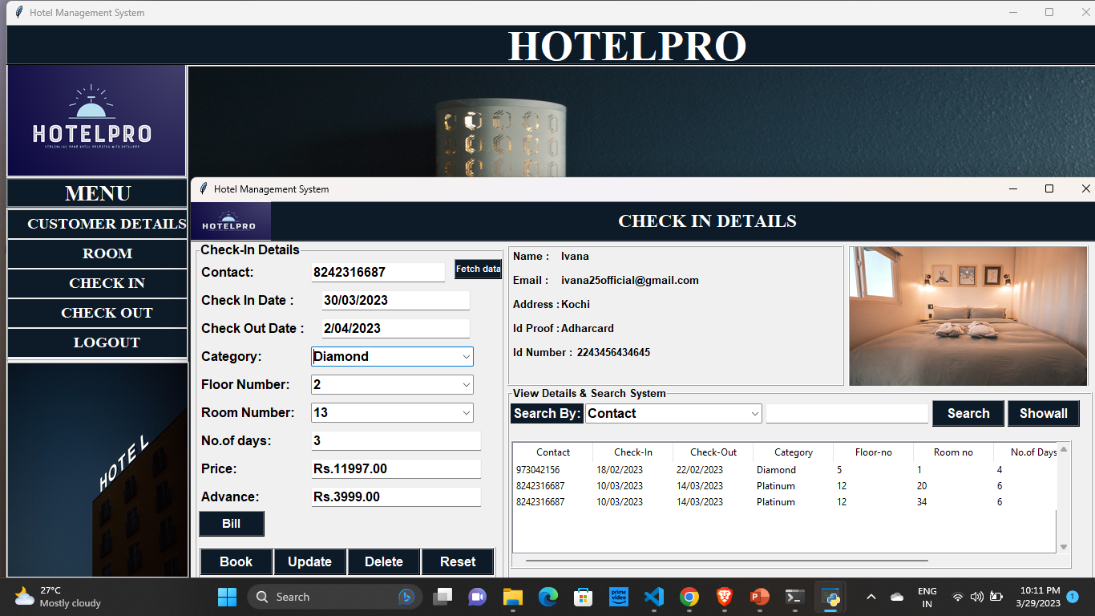
CHECK IN PAGE

Slide 13
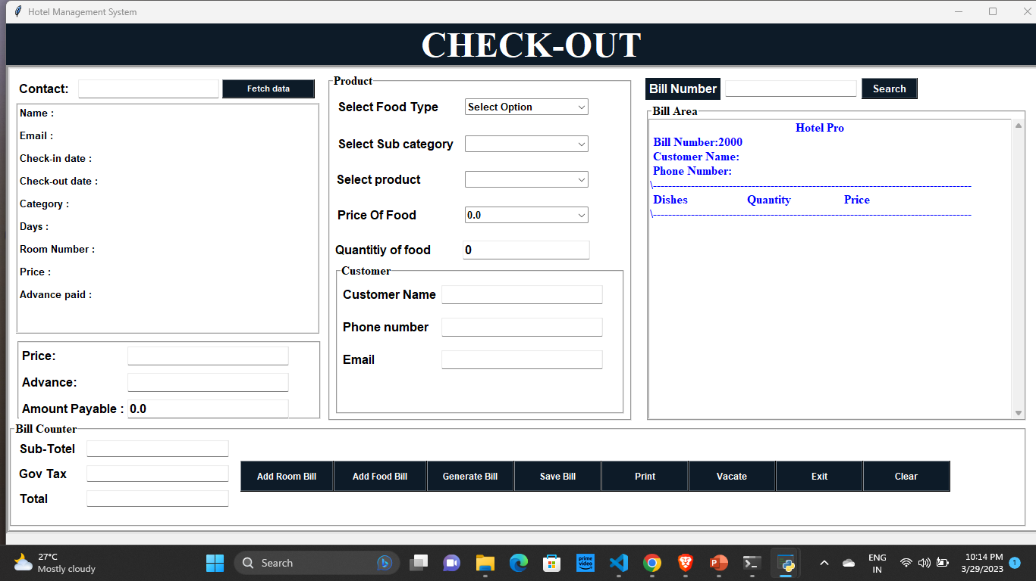
CHECK OUT PAGE

Slide 14
CONCLUSION
In conclusion, the hotel management system using Python is a powerful tool that can help hotel owners manage their business operations more efficiently. With its user-friendly interface and easy-to-use features, the system can help streamline tasks such as room reservations, billing, room management, and check out facility. Additionally, the system is highly customizable and can be tailored to meet the specific needs of individual hotels. Overall, the use of Python in hotel management has the potential to revolutionize the way that hotels operate, and can lead to increased profitability, customer satisfaction, and employee productivity.

Slide 15
REFERENCES
www.google.com
www.youtube.com

Slide 16
THANK YOU

